Slide 1
Improving an Open Source Question Answering System
Salil Shenoy

Slide 2
Outline
Problem Statement
What is a Question Answering System ?
Components of the Question Answering System
Lexicon
Parts of Speech Tagger
Parse Tree Creation
Triplet Extraction Process

Slide 3
Problem Statement
When the user enters any question in Yioop it should be able to return the answer in natural language. Currently, Yioop treats a question and a query in the same way by returning a list of documents.
The main goals for the project 1. Integration of a Question Answering System in Yioop 2. Create a part of speech tagger for a particular language (for example Hindi, Marathi, etc.)

Slide 4
Question Answering [QA] System
Discipline of Computer Science which involves answering questions in natural language
Any QA system depends on a database to answer questions
Short answers in natural language returned instead of list of documents
Can be classified broadly into 1. Open Domain 2. Closed Domain

Slide 5
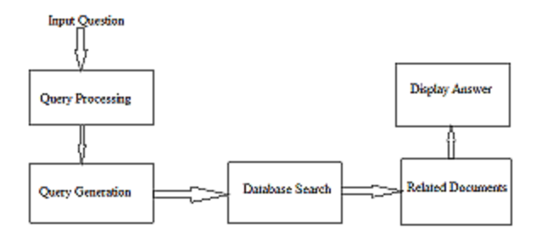
Architecture of QA System

Slide 6
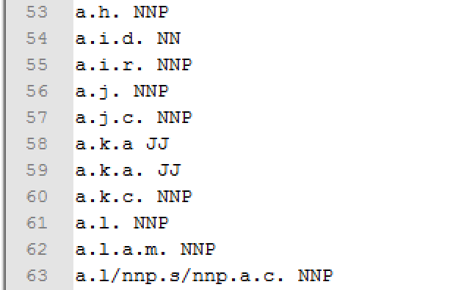
Components of the Question Answering System
Following are the main components of any QA system
Lexicon Sort of dictionary, contains list of words for a given language and Its corresponding part of speech Eg. abandoned VB JJ where VB is verb, JJ is adjective

Slide 7
Components of Question Answering System
Parts of Speech Tagger Example Statement: The grand jury commented on a number of other topics Output of statement The[DT] grand[JJ] jury[NN] commented[VBD] on[IN] a[DT] number[NN] of[IN] other[JJ] topics[NNS]

Slide 8
Components of Question Answering Sys tem
Parse Tree Grammar rules to interpret a common form of a statement
NP: {<DT|JJ|NN.*>+}
PP: {<IN><NP>}
VP: {<VB.*><NP|PP>+}
Statement: {<NP><VP>}

Slide 9
Components of the Question Answering System
Triplet Extraction Algorithm
Subject Extraction : Noun in the NP Sub-tree
Predicate Extraction: Deepest Verb descendent of Verb Phrase
Object Extraction : All siblings of VB in Verb Phrase Sub-tree

Slide 10
QUESTIONS ?

Slide 11
THANK YOU

